Slide 1

Recommendation Engine:
Figuring Out What Your Friends Like
Bill Schreiber
William.Schreiber.jr@gmail.com

Slide 2
What is this about?
Recommendation engine or Collaborative Filter
Like Netflix, Amazon, Facebook etc.
Can be used in conjunction with searches to connect customers to products or content they might not have found otherwise.
What I plan to cover
1. Similarity brings one to things that wouldn’t have gotten to otherwise…
educated guesses
2. How to calculate recommendations – always two calculations
Similarity – different formulas
Probability
3. Recommendation Engine Feedback – closing the loop

Slide 3
Identifying Similar
Pattern Matching
“Hey Fred, I think you should check out this movie. I think you might like it.”
Identifying similar
A
~
B
A
~
C
B
~
C

Slide 4
Business Use Cases for Similarity:
Forecast interest rates, stocks, sales, weather, etc.
A way to make educated decisions based on limited information
A
Kind of Worked
A
~
B
Try it!
C
Didn’t Work
C
~
D
Don’t bother

Slide 5

Similarity Calculations
Allow intuitive leap or educated guess
Recommendation Engine brings users to content or products might not have seen before

Slide 6
Building Recommendations
Always two part calculations
Calculate how similar elements are to each other
Calculate probability will like or dislike
A
~
B

Slide 7
Lots of Computes
Similarity is computationally expensive
Always at least two sets of computations per “rater”
3000 users = 4,498,500 calculations for similarity
3000 products = 4,498,500 + (3000 * 3000) = 13.5 M calcs roughly
Imagine Netflix -
Netflix – 1081 TV series and 4579 movies x 117 M users
117,000,000 similarity = 6844500058500000 calculations
5660 products = 6844500058500000 + (117 M * 5660) = 6.8445 x 10 ¹⁵

Slide 8

Go get a coffee, it is going to be a while
The lights are going to dim…

Slide 9
Step One - Define Similar Between Users or Items
Variation of Jaccard index formula
https://en.wikipedia.org/wiki/Jaccard_index
S(U1, U2) = (L1 intersection L2) + (D1 intersection D2) – (L1 intersection D2) – (L2 intersection D1) / (L1 union L2 union D1 union D2) S(U1, U2) = similarity between user one and user two – a value from -1 to 1 – a zero probability means there isn’t enough data to make a calculation L1 intersection L2 – Number of likes of user one that user two also likes D1 intersection D2 – Number of dislikes that user one and user two also dislike L1 intersection D2 – Number likes that user one has that user two dislikes L2 intersection D1 – Number of likes that user two has that user one dislikes L1 union L2 union D1 union D2-Number of likes for user one plus number of likes for user two plus number of dislikes for user one plus number of dislikes for user two.
Gives value from -1.0 to 1.0

Slide 10
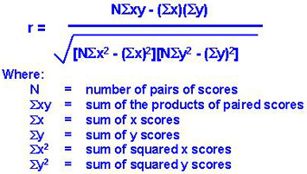
Step One – Another Formula For Similar
Pearson’s Correlation Coefficient
https://en.wikipedia.org/wiki/Pearson_correlation_coefficient

Slide 11
Step One – Other Approaches To Define Similar
Singular Value Decomposition
https://en.wikipedia.org/wiki/Singular-value_decomposition
Doesn’t work well on missing data
Model based
Factors user item matrix into smaller matrix
Item Based Collaborative Filtering – looks for similar items, not users
Cosine Similarity
https://en.wikipedia.org/wiki/Cosine_similarity
Use Them All

Slide 12
Step Two - Calculate Probability User Likes Ratee, Article or Product
P(U,A) = (Zl – Zd) / (Ml + Md)
P(U,A) – the probability that a user or rater will like a particular ratee or article. Zl-sum of similarity indices of users or raters who have liked the article Zd- sum of similarity indices of users who have disliked the article Ml-total number of users or raters who have liked the article or ratee. Md-total number of users or raters who have disliked the article or rate.

Slide 13
Recommendation Accuracy
Human evaluation – hmmmm
User follow through
Revenue generated
Number who picked recommended items
Example – number with recommend item as first in basket – home run!

Slide 14
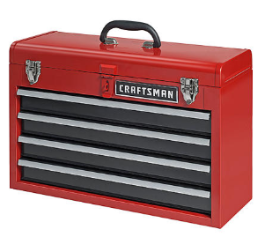
Conclusion
Similarity
Intuitive leap or educated guess
Recommendation Engine
Connects users to products or content they might not have seen otherwise
Architect’s Tool Chest

Slide 15

Thank you for listening…
You have been a great audience.
I would recommend you to anyone.

Slide 16
References
https://www.codeproject.com/Articles/1233227/Recommendation-Engine
https://www.toptal.com/algorithms/predicting-likes-inside-a-simple-recommendation-engine
https://en.wikipedia.org/wiki/Jaccard_index
https://en.wikipedia.org/wiki/Pearson_correlation_coefficient
https://www.slideserve.com/jerod/chapter-10-section-1-scatter-diagrams-linear-correlation
https://en.wikipedia.org/wiki/Singular-value_decomposition

